Slide 1
F. H. Collins Secondary School
Course Selection
for
2020-2021 School Year

Slide 2
Grade Nine
English 9
Mathematics 9
Science 9
Social Studies 9
Physical Education 9
Second Language 9
Elective
Elective
Elective
Elective
English 9
Mathématiques 9
Sciences 9
Sciences humaines 9
Français langue 9
Physical Education 9
Elective
Elective
Elective
Elective

Slide 3
Pathway to Graduation
80 credits / 20 courses
•English 10
•Math 10 / Mathématiques 10
•Social Studies 10 / Sciences humaines 10
•Science 10 / Sciences 10
•Career Life Education 10/Éducation à la carrière 10
•Physical Education 10
•English 11
•Math 11 or 12 / Mathématiques 11 ou 12
•1 Social Studies 12/ Sciences humaines 12
•1 Science 11 or 12
• 1 Approved Fine Arts or Applied Skills (10-12)
English 12
Grade 12 Elective
Grade 12 Elective
Grade 12 Elective
4 additional electives (10-12)
Career Life Connections 12
• 30 hrs Work Experience
• 2.5 hrs/wk Physical Activity
• Post-Secondary Planning
• Français langue (10, 11, 12)
*A total of six Immersion courses
Grades 10-12

Slide 4
Grade Ten
English 10
Mathematics 10
Science 10
Social Studies 10
Physical Education 10
Career Life Education 10
Elective 10 (2nd lang.)
Elective 10
English 10
Mathématiques 10
Sciences 10
Sciences humaines 10
Physical Education 10
Éducation à la carrière 10
Français langue 10
Elective 10

Slide 5
Math 10
Workplace Math 10
Foundations and Pre-calculus 10
Extended Foundations & Pre-cal 10 (over 2 semesters) and a possibility of A&W10
Les mathématiques pour les métiers et le millieu de travail 10
Fondements des mathématiques et pré-calcul 10

Slide 6
English 10
English 10 First Peoples
New Media 10 and
Spoken Words 10
English 10
Composition 10 and
Creative Writing 10 or
Literacy Studies 10

Slide 7
Grade Eleven
English 11
Mathematics 11 or 12
1 Science 11 or 12
1 Social Studies 12
Elective
Elective
Elective
Elective
English 11
Mathématiques 11 ou 12
1 Sciences 11 or 12
1 Sciences humaines 12
Français langue 11
Elective
Elective
Elective

Slide 8
English 11
English 11 First Peoples
Literary Studies and
-New Media 11 or
-Spoken Language 11 or
-Writing 11

Slide 9
Math 11
Workplace Math 11
Foundations of Math 11
Pre-calculus Math 11
Les mathématiques pour les métiers et le milieu de travail 11
Fondements des mathématiques 11
Pré-calcul 11

Slide 10
Grade Twelve
English Studies 12 or English 12 First Peoples
Elective 12
Elective 12
Elective 12
Elective 12
Career Life Connections 12
English Studies 12 or English 12 First Peoples
Français 12
Elective 12
Elective 12
Elective 12
Career Life Connections 12

Slide 11
Grade Twelve Electives
Academic Electives
Non-Academic Electives
Math (Foundations, Pre-calculus, Calculus, AP Calculus)
Anatomy and Physiology, Chemistry, Physics, Geology, Environmental Science, 20th Century World History, Literature, Yukon First Nations, Social Justice, Comparative World Religions, Human Geography, Comparative Cultures, Creative Writing, Law Studies
French, Français Langue, Spanish
Math (Apprenticeship & Workplace)
Work Experience, Carpentry, Auto, Metal, Physical, Education, Psychology, Art, Instrumental Music (Band), numerous other courses
External credits

Slide 12
External Credits
Driver’s Ed 11 (2 credits)
Bronze Cross (2 credits)
NLS (2 credits)
Swim Instructor (2 credits)
Scuba Diving
Athlete 10, 11 & 12 (4 credits each)
Royal Conservatory 10, 11 & 12 (4 credits each)
••• and many more

Slide 13
Keep Your Options Open
• Take a minimum of four to six academic grade 12 courses
• Check pre-requisite courses needed for your future desired program

Slide 14
University Admission Requirements
Science/Engineering
Humanities (Arts)/Fine Arts
English 12
Math 12 – Pre-calculus
Science 12
Science 12
Additional course for Alberta and Ontario
*Science – may require
Physics 11
* Chemistry 12 & Physics 12 for Engineering, recommend Calculus 12
English 12
3 0r 5 Grade 12 Academics
*Language 11 (Some universities)
* Math 11 (Foundations or Pre-calculus – check with university)

Slide 15
Programs
https://www.fadsyukon.com/
http://www.woodstreetcentre.ca/

Slide 16
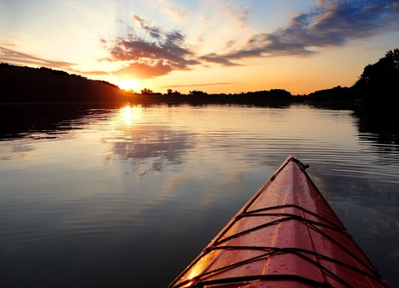
PASE 9 Plein Air et Sciences Environementales
PASE Semester
Alternate Semester
Sciences 9
Sciences humaines 9
Éducation physique 9
Plein Air 10
English
Mathématiques 9
Français langue 9
Elective

Slide 17
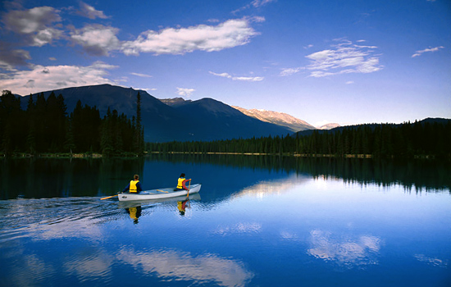
FACES – French - Achievement◊Challenge◊ Environment◊Stewardship
FACES Semester
Alternate Semester
Sciences humaines 10
Sciences naturelles 10
Éducation physique 10
Plein Air 10
English 10
Français Langue 10
Mathématiques 10
Éducation à la carrière 10

Slide 18
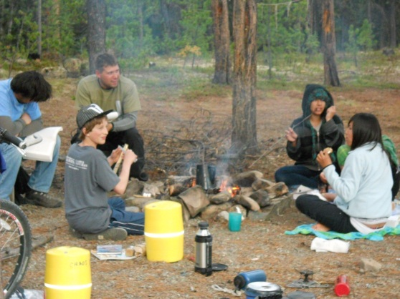
CHAOS 9 Community◊Heritage◊Adventure◊Outdoors◊Skills
CHAOS Semester
Alternate Semester
English 9
Social Studies 9
Ancestral Technology 9
Physical Education 9
Math 9
Science 9
2nd language 9/elective 9
Elective

Slide 19
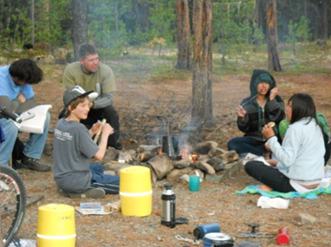
CHAOS 10 Community◊Heritage◊Adventure◊Outdoors◊Skills
Chaos Semester
Alternate Semester
English First Peoples 10
Social Studies 10
Physical Education 10
Ancestral Technology 10
Math 10
Science 10
Career Life Education 10
Elective 10\2nd language

Slide 20
Sport School for FH Collins
If you are interested in becoming a better athlete then you should consider signing up for the new FH Collins Sport School.
The school will focus on 3 movement areas Olympic lifting, Gymnastics and Sprinting.
These activities will boost your power and strength for any sport.
There will be tutorial and presentations by experts in nutrition, psychology, injury prevention and rehabilitation etc.

Slide 21
F.E.A.S.T. Program
Interested in working in the Food Industry? Want to become a better cook ?
F.E.A.S.T. is a program that will be offered as a half day program, in A and B block where students will work towards building skills that could allow them to pursue a career in the food industry.
Students will focus on baking techniques, creating healthy meals that can feed small and large groups and service techniques.
Students may have the opportunity to work in food service establishments across the community.

Slide 22
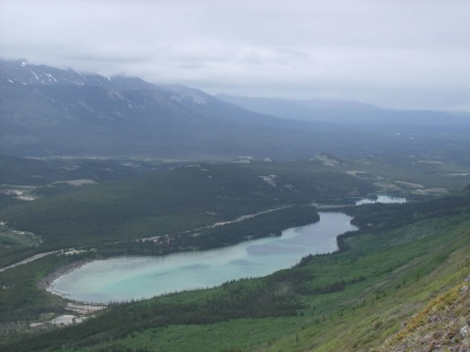
OPES 9 Outdoor Pursuits◊Experiential Science
Alternate Semester
OPES Semester
Mathematics 9
English 9
Elective
Elective/2nd Language
Science 9
Social Studies 9
Physical Education 9
Outdoor Education 10

Slide 23
ACES 10 Achievement◊Challenge◊Environment◊Stewardship
Alternate Semester
ACEs Semester
English 10
Mathematics 10 / Mathématiques 10
Career Life Education 10/Éducation à la carrière 10
Elective (2nd lang.) / Français langue 10
• Science 10
• Social Studies 10
• Physical Education 10
• Outdoor Pursuits 10

Slide 24
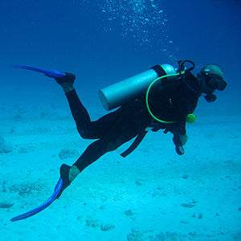
ES 11 Experiential Science
Alternate Semester
ES Semester
English 11
Mathematics 11 / Mathématiques 11
Elective / Français langue 11
Elective
Biology 11
Chemistry 11
Geography 12
Physical Education 11
Fine Arts 11 (2 credits)
Applied Skills (2 credits)

Slide 25
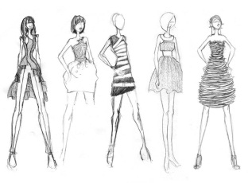
FADS 10 Fashion Arts and Design School
Alternate Semester
FADS Semester
Two of those;
1-Science 10, Mathematics 10
or English 10
3- Career Life Education 10
4- Elective (2nd lang.)
Studio Arts: Fabric and Fiber - 4 credits
Visual arts - 4 credits
Textiles - 4 credits
Social Studies- 4 credits
1 Academic course-4 credits (outside of FADS)

Slide 26
FADS 11/12 Fashion Arts and Design School
FADS Semester
Alternate Semester
Studio Arts: Fabric and Fibre - 4 credits
Visual arts - 4 credits
Textiles - 4 credits
A Social Studies- 4 credits
1 Academic course-4 credits (outside of FADS)
English 11 or 12
a Math 11 or Elective
a Science 11 or Elective
Elective (second language)

Slide 27
MAD 9 MUSIC ART & DRAMA
MAD Semester
Alternate Semester
English 9
Social Studies 9
Drama – General 10
Physical Education 9
Mathematics 9 / Mathématiques 9
Science 9 / Sciences 9
Elective / Français langue 9
Elective

Slide 28
MAD 10 Music, Art and Drama
MAD Semester
Alternate Semester
English 10
Social Studies 10
Drama 10
Physical Education 10
• Mathematics 10 /
Mathématiques 10
• Science 10 / Sciences 10
• Career Life Education 10/ Éducation à la carrière 10
• Elective (2nd lang.) /
Français langue 10

Slide 29
MAD 11 Music, Art and Drama
First Semester
Second Semester
Mathematics 11 / Mathématiques 11
1 Science 11
Elective (2nd lang.) / Français langue 11
Elective
English 11
Social Studies 12
Dance Performance 11
Theatre Performance 11 (Acting)

Slide 30
MAD 12 Music, Art and Drama
First Semester
Second Semester
Elective 12
English 12
Dance Performance 12
Theatre Performance 12 (Acting 12)
Theatre Production 12
Career Life Connections 12

