Slide 1
Post Secondary Information
FH Collins secondary school
2022-2023
M. Morris, J.Tuton, A.Alwarid

Slide 2
2 Presentations for Grade 12 students
Fall: Application process Early Admissions Transcripts Creating a BCeID account Scholarships ($) | Spring: Student Financial Aid Yukon Grant

Slide 3
Educational attainment for the population aged 25 to 64, Canada, 2020 Census
 | %
Less than high school | 8
University | 34
College | 26
Apprenticeship or Trades | 10
High School Diploma | 22

Slide 4
Choosing a school
 Do they have the program I want or that I can transfer in to?
 Proximity to the Yukon
 Family and friends in the new city
 Academic reputation
 Co-op programs
 Opportunities to be hired after completing schooling
 Cost
 Guaranteed residence for 1st year students
 Lifestyle

Slide 5
Trades & Apprenticeships
 https://yukon.ca/en/education-and-schools/apprentices-and-trades
 3 way agreement between the apprentice, Yukon Apprenticeship and the Employer
 Foundation Year or Pre-Apprenticeship Programs
 For questions or to book an apprenticeship orientation meeting, email apprenticeship@yukon.ca or phone 867-456-3867
 Apprenticeship training agreement with Alberta

Slide 6
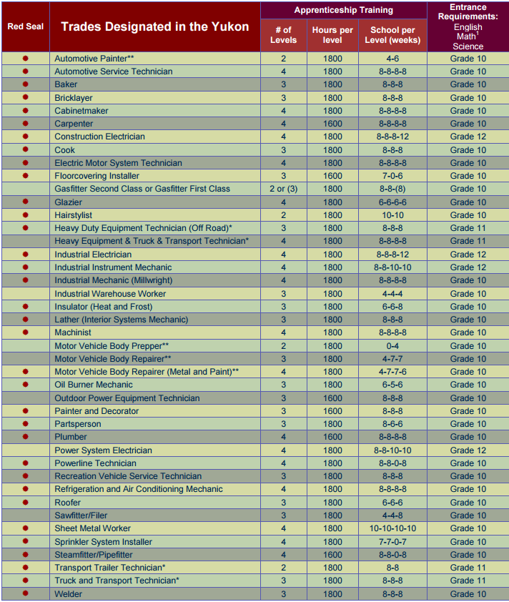

Slide 7
College
 Certificate or Diploma (1 or 2 years)
 Limited seats: first applied, first eligible, first accepted
 Be mindful of grade 11 requirements for admission
 Look to see if your program transfers to another institution to complete a higher level. Example LPN or Northern Science at YukonU

Slide 8
University
 3 or 4 year degree: Bachelor of ____________
 Admission is based on your competitive average and sometimes a personal profile
 Arts: English 12 and 3 or 4 Academic Grade 12 courses
 Science: English 12, Pre-Calculus 12, 2 Academic sciences and sometimes one other course.
 Fine Arts: Academic plus portfolio
 Admission deadlines vary often December-February.

Slide 9
Early Admission
 For University Applications
 Based on your Grade 11 marks
 Need to ensure that you have the required Grade 12 courses on your transcript
 Most universities are open early to mid October
 Scholarships

Slide 10
Application Centers
Education Planner BC https://www.educationplannerbc.ca/
Apply Alberta https://applyalberta.ca/
OUAC https://www.ouac.on.ca/
Ontario Colleges https://www.ontariocolleges.ca/en
Credit card needed to apply. Application costs vary

Slide 11
Transcripts
 Record of your high school courses and marks used for admission
 Self declare, through your BCeID account. Most universities are requiring them sent through your BCeID account.
 Final/Official Transcript: Sent through BCeID mid summer.
https://www2.gov.bc.ca/gov/content/education-training/k-12/support/transcripts-and-certificates

Slide 12
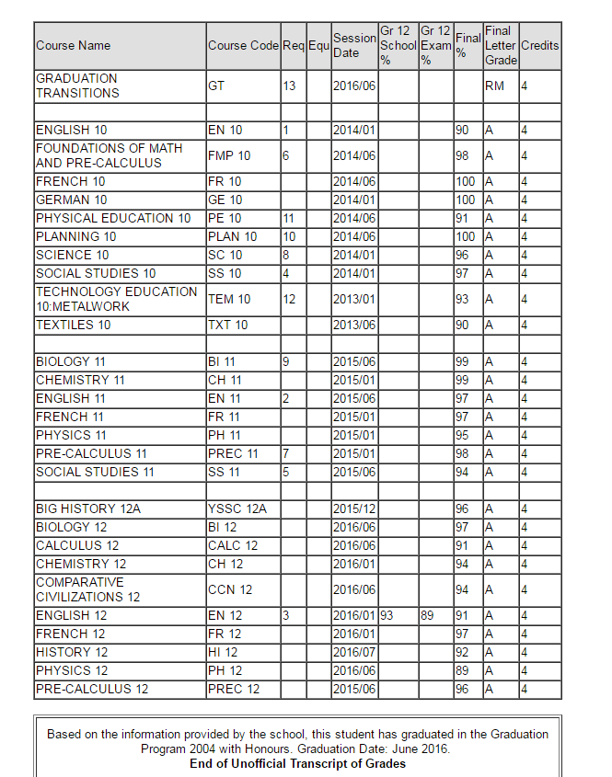
EXAMPLE OF A STUDENT’S TRANSCRIPT

Slide 13
Scholarships and Money
 Early admission for big university entrance scholarships
 Automatic (no application) scholarships for competitive average
 Yukon Foundation
 Schulich, Horatio Alger, Loran, TD, Indspire, Burger King, Canada Post
 Scholarships Canada
 Volunteer work and marks.
 Yukon Excellence Awards $3000 max
 Yukon Grant $4390 plus $1500 travel (per year for 5 years)

Slide 14
Six Advantages of Working After High School
Earn Money Instead of Spending It!
Learn to Appreciate School
Gain Life Experiences
Put More Thoughts Into Your Future Career
Decide if School Is the Right Path for You
Brain Maturity Extends Well Beyond Teen Years

Slide 15
Final Tips
 Create a folder on your phone with login and password information
 Check your email regularly including junk folder
 Allow a parent to have access to your information
 Be very aware of deadlines
 Read emails on a computer not just your phone
 Start now to explore options for reference letters for scholarships
 1 st choice/ 2nd choice

