Slide 1
FHC – Grade 8 Orientation
Proud to Learn Together on the Traditional Territories of the Kwanlin Dün First Nation & Ta'an Kwach'an Council

Slide 2
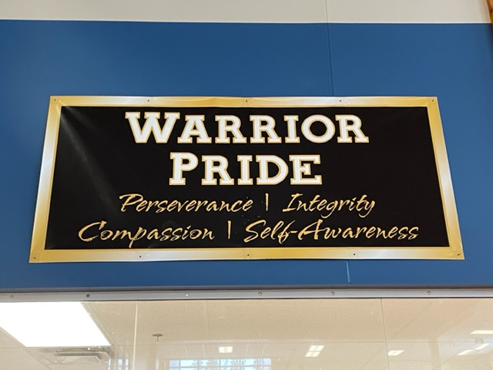
Welcome to FHC Pride: Perseverance, Integrity, Compassion, Self-Awareness

Slide 3
Draw prizes –
do you have your ticket?
Introductions: Admin, Counsellors, Teachers

Slide 4
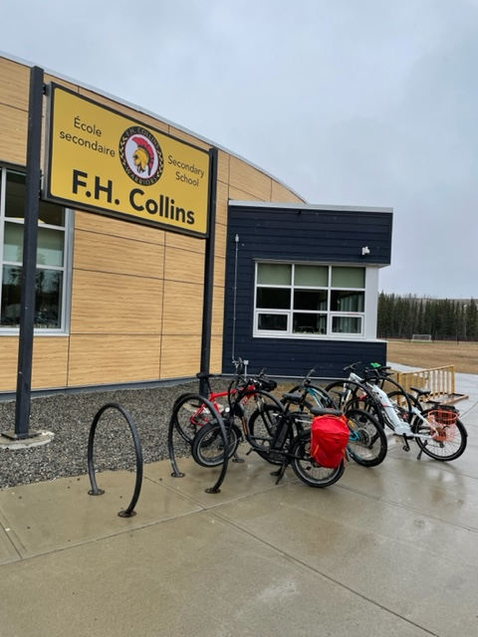
FRIDAY, AUGUST 19 @ NOON: Open House & SCHEDULES →if schedules are available prior to that time guardians will be notified by email that schedules are available
First Day, MONDAY, AUGUST 22
School Day Starts +/- 8:35 & ends +/-3:10
→four classes per day; Day one/two
→Please arrive 10-15 minutes early
→Students strongly encouraged to walk, bike or bus. If you must be dropped off consider being dropped off at the S.S. Klondike
→If student has not yet received a schedule it will be available in front office or atrium
→Barring COVID, feel free to hang out in halls (find classes), gym or atrium
→BRING A LUNCH (typically the cafeteria/Food For Learning Program is not up and running for at least the first week)
→Barring COVID an all-student assembly will occur first @ 8:35, grade 9-12’s will then be dismissed to classes and grade 8’s will remain in gym
→After the assembly students will go to their first class of the day: lockers assigned
→When ‘house-keeping’ complete rest of the day will proceed as per usual

Slide 5
School Fees $25/students, $50/family. Cheques payable to FH Collins. Note: may be additional fees for individual classes, especially options.
FHC Grade 8 – 2022/23 School Supply List (Google FH Collins→Student→School Supplies and Fees
4 2-inch binders
4 Binder divider packages
500 Sheets of lined loose leaf note paper
10 HB pencils
1 Set Coloured pencils
5 Blue and/or black ballpoint pens
2 White erasers
1 Geometry set (ruler, protractor and compass)
1 Calculator (a scientific calculator will be required in grade 9)
1 Scissors
2 Glue Sticks
2 or 3 Sheets of poster board- for class projects (keep at home until needed)
1 USB computer memory stick (smaller, less expensive version is fine)
1 School bag

Slide 6
Questions???? Extra curricular sports and clubs? Cafeteria? Free time? Other??
Athletics: Volleyball, Basketball & more
Social Justice Club
Waterloo Math
Dungeons and Dragons Club

Slide 7
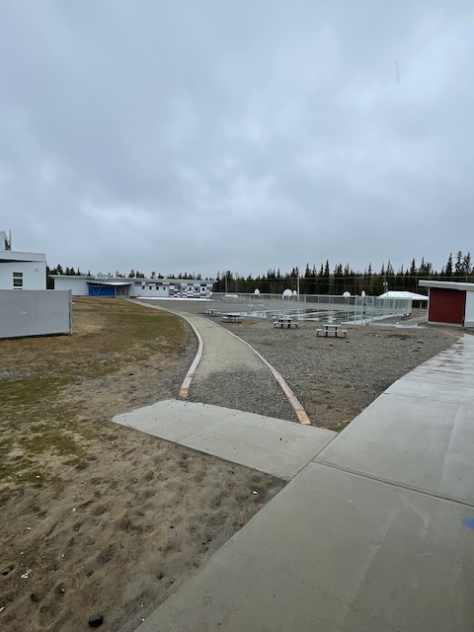
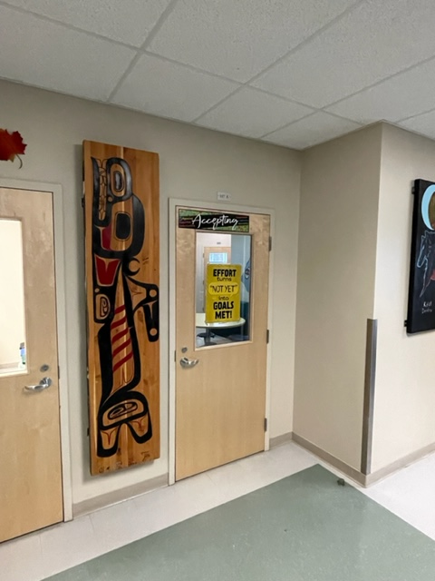
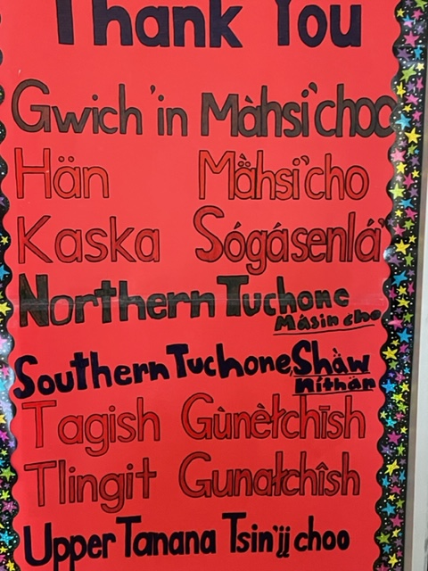
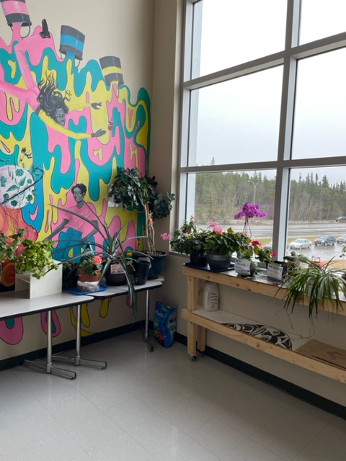
Feel Free to explore…can you find:
The Learning Space/FN area
Tis view of path to IA wing
This Sign
Toews’ favourite place

