Slide 1
École FH Collins School

Slide 2
Mission Statement
We treat all people with respect, compassion and kindness.
We act with honesty, integrity and fairness.
We treat each other with loyalty, respect and dignity.

Slide 3
Extra Curricular
Social Justice
Gay Straight Alliance
Drama
Applied Skills
Chess Club
Math-letics
Guitar Club
Destination Imagination
Student council
D&D club
Cooking club

Slide 4
Athletics
Volleyball
Mountain Biking
Arctic Sports
Basketball
Badminton
Cross Country Running
Track and Field

Slide 5
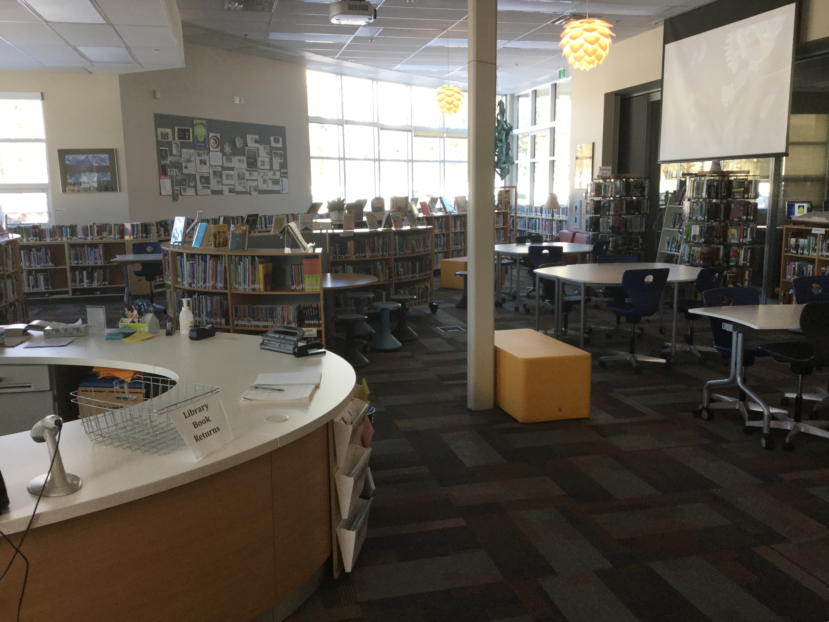
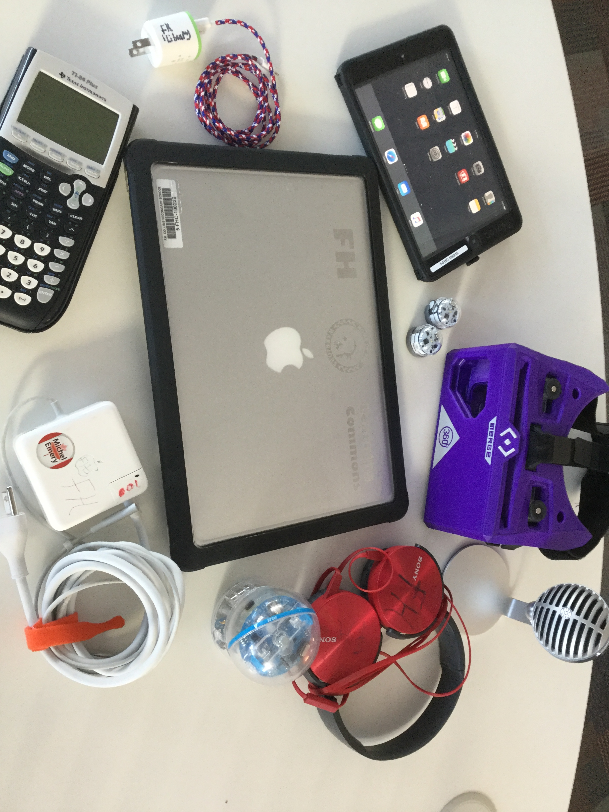
iLibrary – Learning Commons
Study
Collaborate
Research
Design
Communicate
Present
Innovate

Slide 6
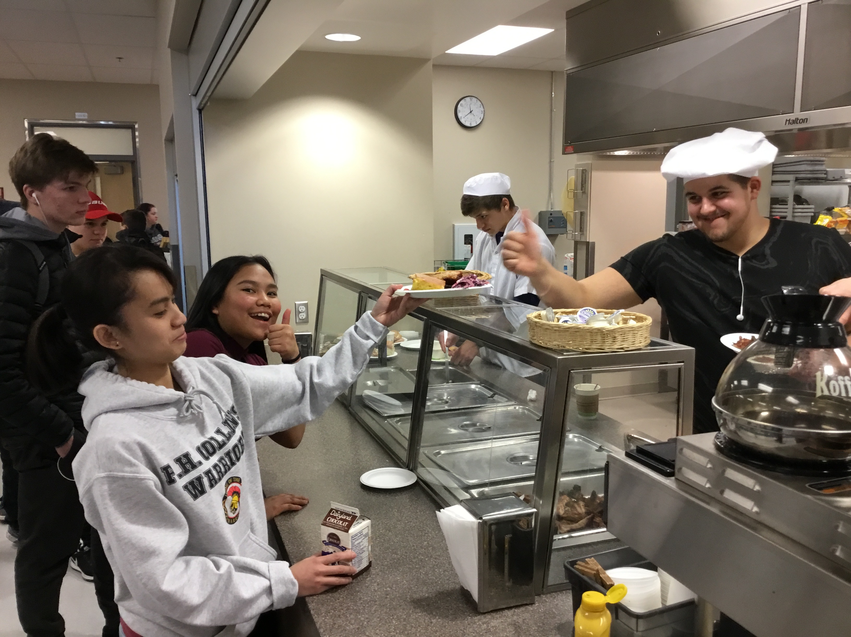
FH Collins– Cuisine
Kitchen Hours
Break
Lunch

Slide 7
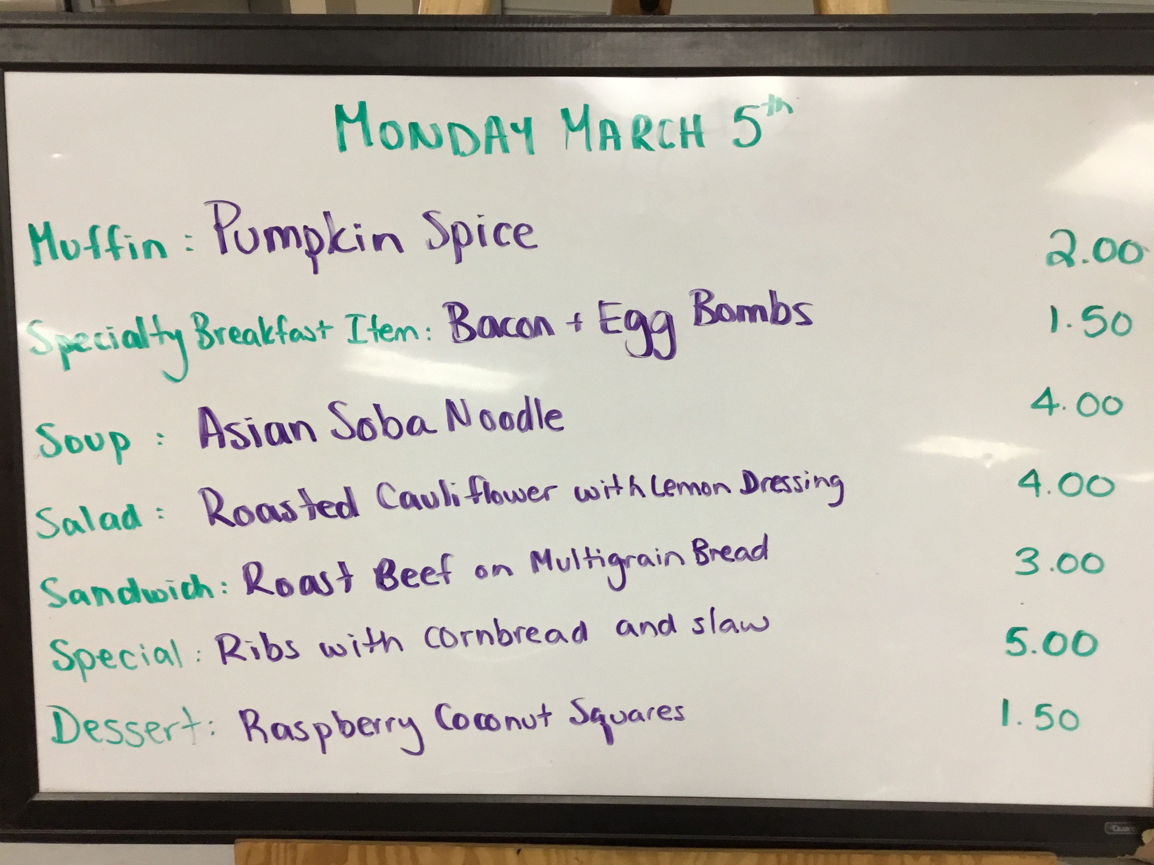
FH Collins– Cuisine -Amazing Food
Chef Suzie Leamen

Slide 8
What might next year look like?
Courses you will need to take
Sciences Humaines 8
English 8
Sciences 8
Mathématiques 8
Français 8
Éducation Physique 8
Digital literacy 8
Leadership 8
Applied Skills 8/ Fine Arts 8 (Electives)
Or BAND!!!!

Slide 9
Electives
Beginner and Advance Band
Animation -
Drafting and Design
Arts
Outdoor Pursuits
Metals
Applied Science
Foods
Robotics
Auto
Woods
Drama

Slide 10
FH Student Support Team
Teachers
Learning Assistance
- Educationnal Assistants
Community Support Workers
ELL support
Counsellors
Administrators

Slide 11
Elementary Graduates
Transitioning to FH
‘It’s a big change and is scary at first’
‘more freedom’
‘you meet a lot of new friends’
‘you won’t get shoved in a locker!’
‘don’t stand in the middle of the hallway!’

Slide 12
What questions do you have or What have you heard?

